Slide 1
Chapter 2
Process Models
Slide Set to accompany Software Engineering: A Practitioner’s Approach, 7/e
by Roger S. Pressman
Slides copyright © 1996, 2001, 2005, 2009 by Roger S. Pressman
For non-profit educational use only
May be reproduced ONLY for student use at the university level when used in conjunction with Software Engineering: A Practitioner's Approach, 7/e. Any other reproduction or use is prohibited without the express written permission of the author.
All copyright information MUST appear if these slides are posted on a website for student use.
SLIDE SET 3

Slide 2
A Layered Technology
Software Engineering
tools
methods
process model
a “quality” focus

Slide 3
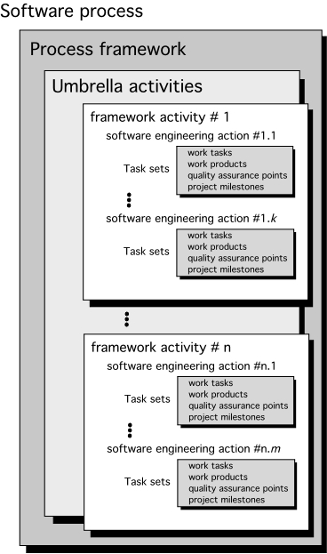
A Generic Process Model

Slide 4
A Process Framework
Process framework
Framework activities
work tasks
work products
milestones & deliverables
QA checkpoints
Umbrella Activities

Slide 5
Framework Activities
Communication
Planning
Modeling
Analysis of requirements
Design
Construction
Code generation
Testing
Deployment

Slide 6
Umbrella Activities
Software project management
Formal technical reviews
Software quality assurance
Software configuration management
Work product preparation and production
Reusability management
Measurement
Risk management

Slide 7
What is a Process?
(Webster) A system of operations in producing something; a series of actions, changes, or functions that achieve an end or a result
(IEEE) A sequence of steps performed for a given purpose

Slide 8
What is a Software Process?
(SEI) A set of activities, methods, practices, and transformations that people use to develop and maintain software and the associated products (e.g., project plans, design documents, code, test cases, and user manuals)
As an organization matures, the software process becomes better defined and more consistently implemented throughout the organization
Software process maturity is the extent to which a specific process is explicitly defined, managed, measured, controlled, and effective

Slide 9
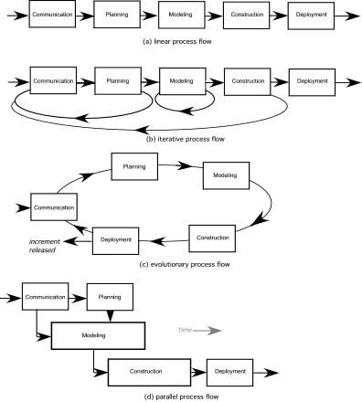
Process Flow

Slide 10
Identifying a Task Set
A task set defines the actual work to be done to accomplish the objectives of a software engineering action.
A list of the task to be accomplished
A list of the work products to be produced
A list of the quality assurance filters to be applied

Slide 11
Software life cycle
Series of identifiable stages that a software product undergoes during its life time:
Feasibility study
Requirements analysis and specification,
Design,
Coding,
Testing
maintenance.

Slide 12
Software Life Cycle
identifies all the activities required for product development,
establishes a precedence ordering among the different activities,
Divides life cycle into phases.

Slide 13
Life Cycle Model is Adhered to,
the project manager can at any time fairly accurately tell,
at which stage (e.g., design, code, test, etc. ) of the project is.
Otherwise, it becomes very difficult to track the progress of the project
the project manager would have to depend on the guesses of the team members.

